Slide 1

Protecting Oklahoma Scenic Rivers and Lake Tenkiller
Save the Illinois River, Inc., STIR
Since 1984

Slide 2

Phillip Lorenz

Slide 3
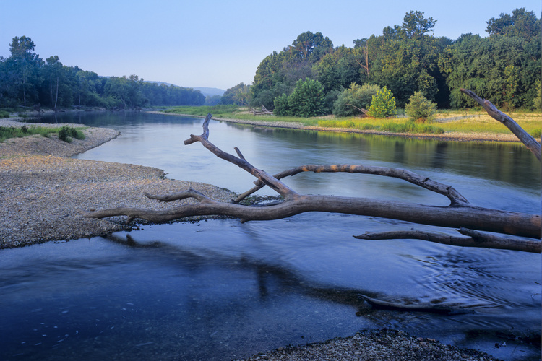
Barrenfork Creek at the Illinois River

Slide 4
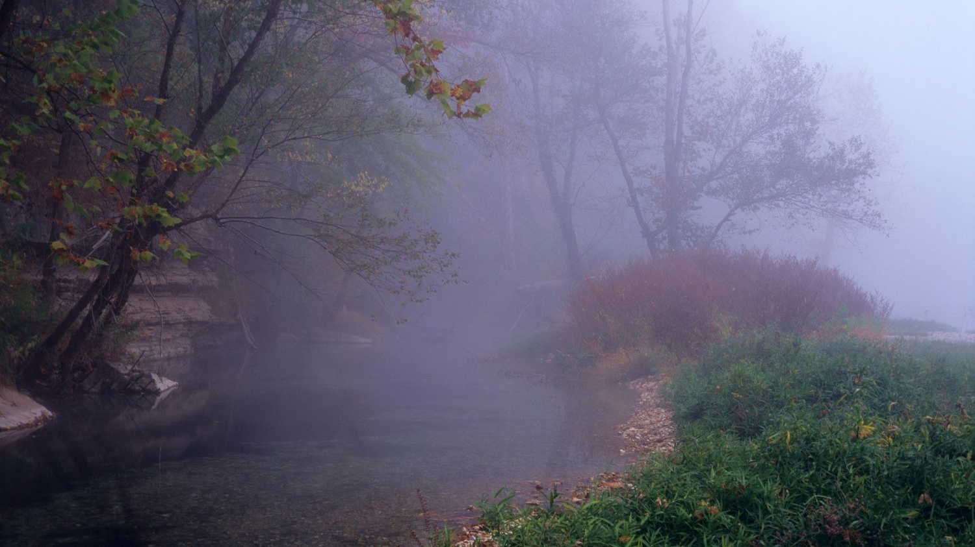
Barren Fork Creek

Slide 5
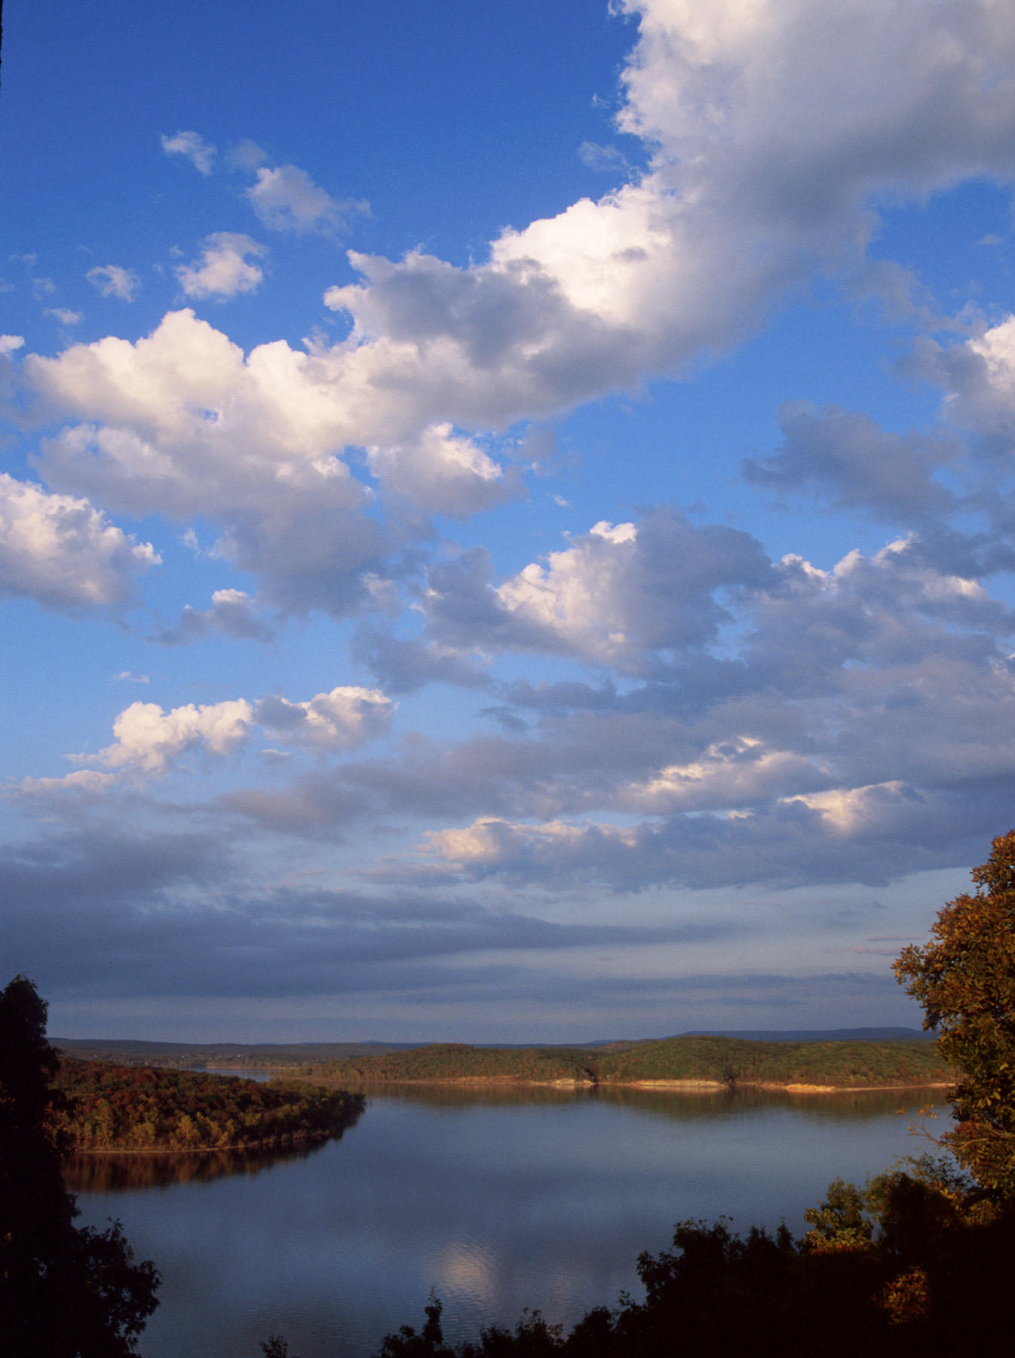
Lake Tenkiller

Slide 6
Designated Oklahoma Scenic Rivers Oklahoma Scenic Rivers Act 1970
Illinois River
Flint Creek
Barren Fork Creek
Lee Creek
Little Lee Creek
Upper Mountain Fork River

Slide 7
See: Title 82, sections 896.1 to 896.16
The Oklahoma Legislature finds that some of the free-flowing streams and rivers of Oklahoma possess such unique natural scenic beauty, water conservation, fish, wildlife and outdoor recreational values of present and future benefit to the people of the state that it is the policy of the Legislature to preserve these areas for the benefit of the people of Oklahoma. For this purpose there are hereby designated certain "scenic river areas" to be preserved as a part of Oklahoma's diminishing resource of free-flowing rivers and streams

Slide 8
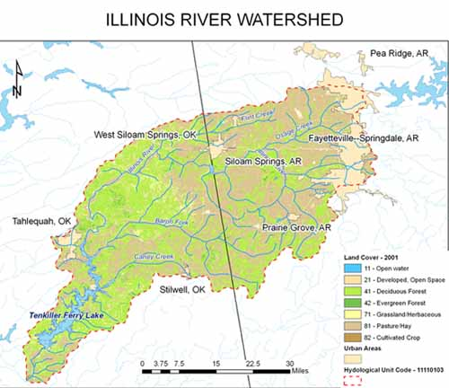

Slide 9
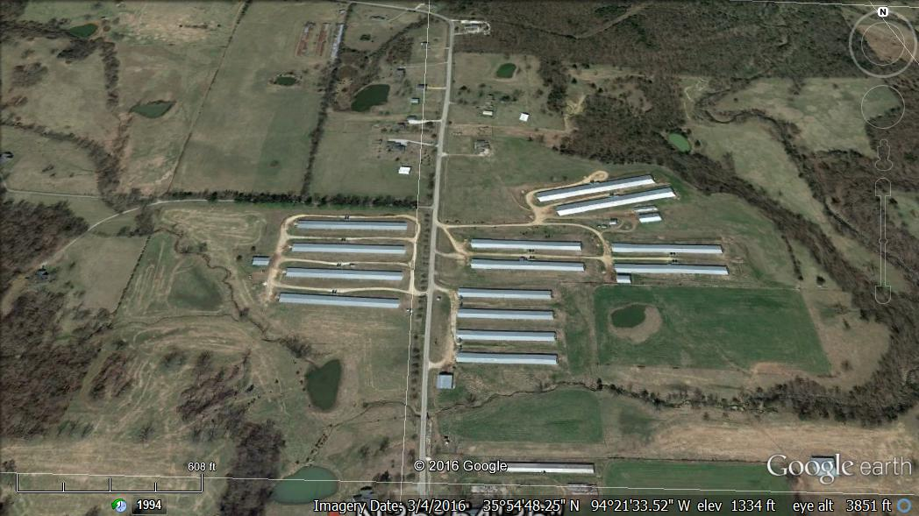
Mega Poultry Barns in Delaware County, Oklahoma

Slide 10
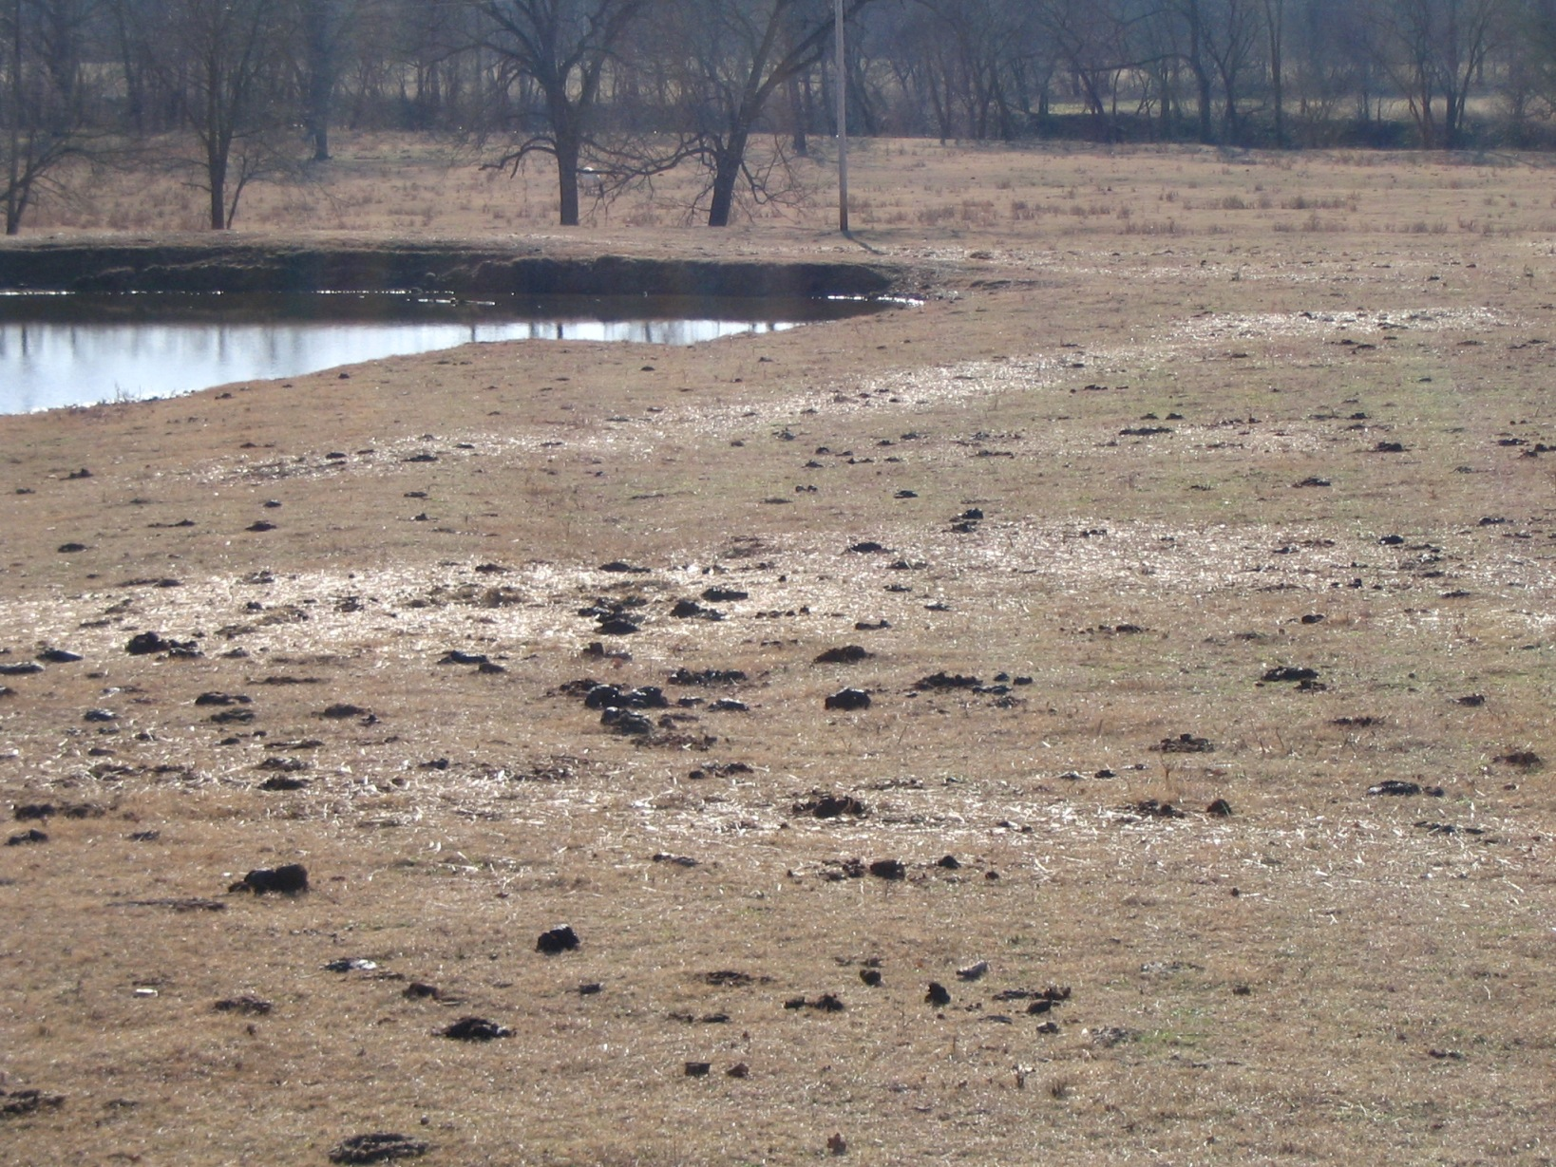

Slide 11
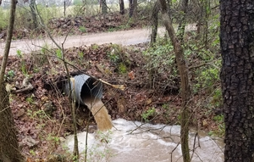

Slide 12
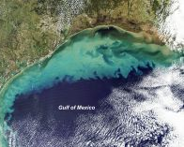
Gulf of Mexico Dead Zone (Hypoxic Zone)

Slide 13
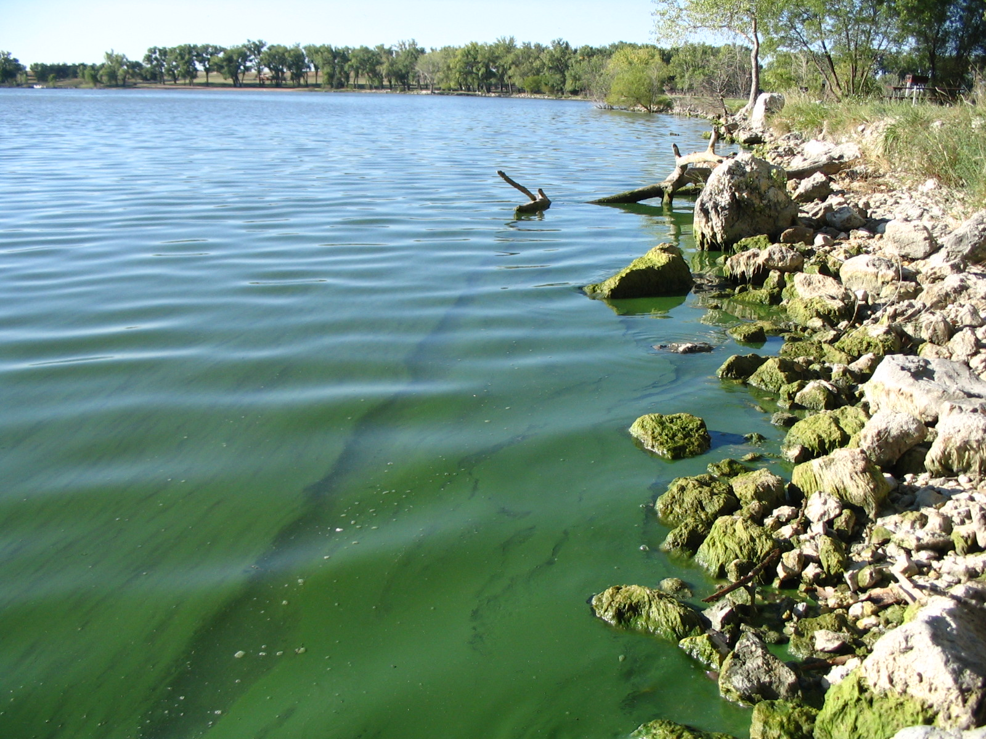
Blue Green Algae. Can be Toxic

Slide 14
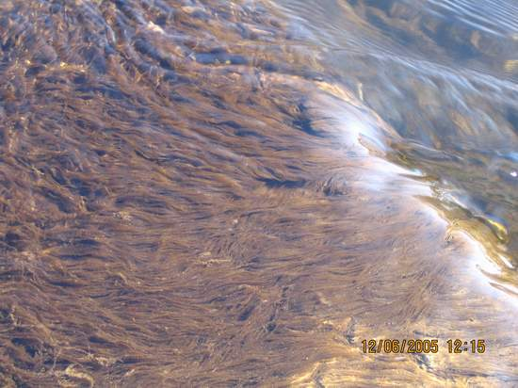
Algae

Slide 15
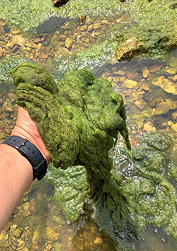
Cladophora Algae
Locals call it “Horse Snot” Algae

Slide 16
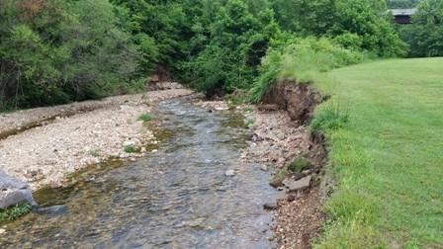
Streambank Erosion and Channelization

Slide 17
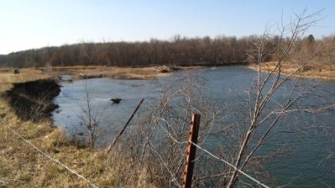
Barren Fork Creek Streambank Erosion

Slide 18
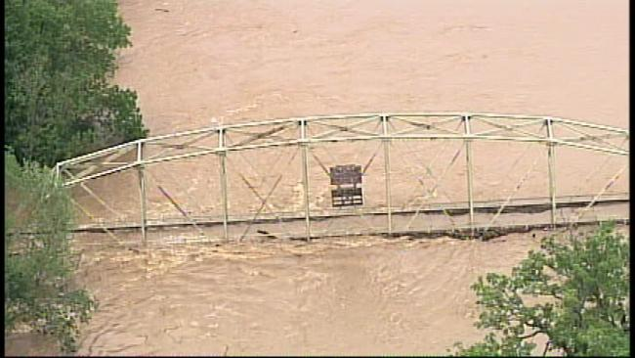

Slide 19
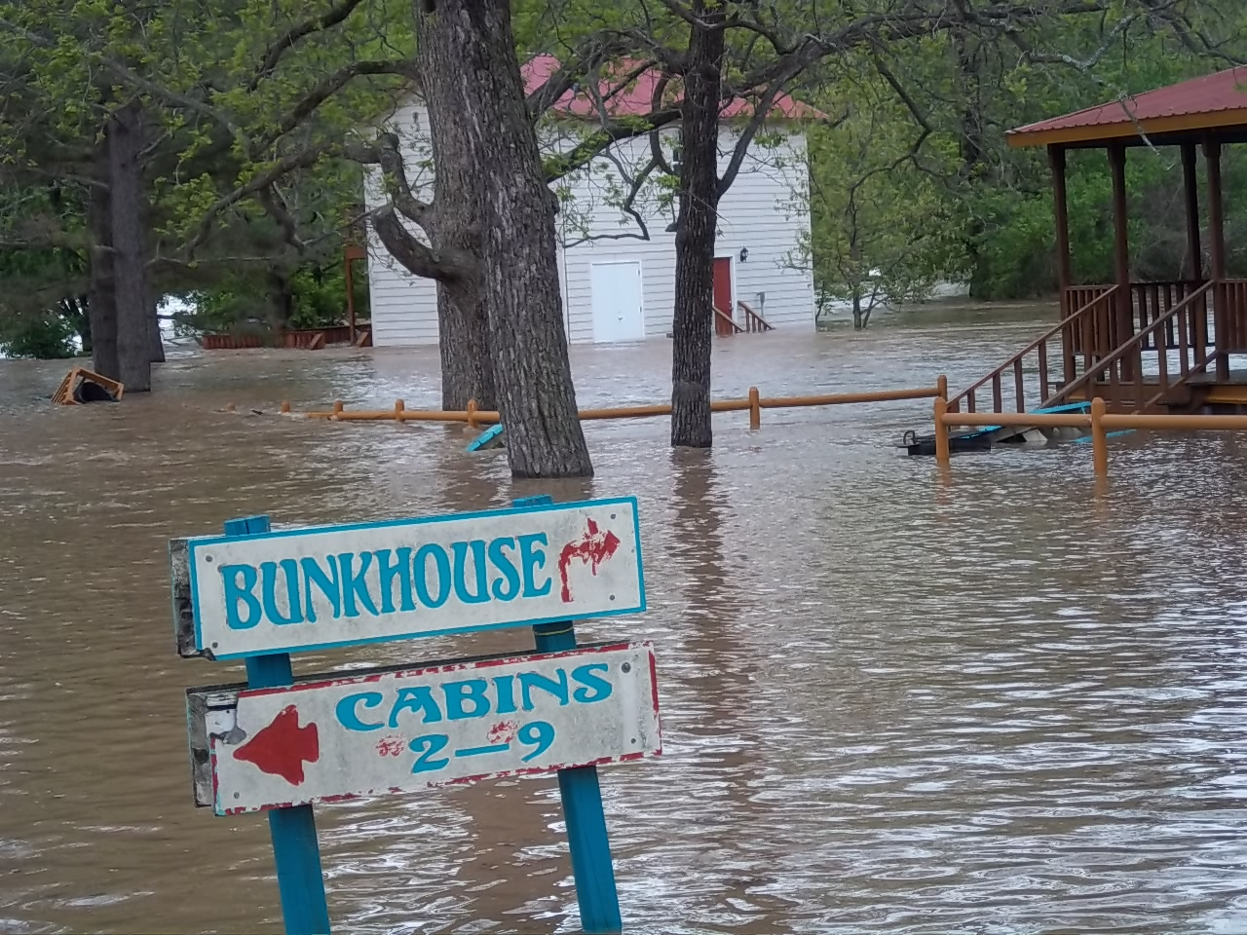
Flooding/Climate Change

Slide 20

Two-Year Baylor University Phosphorus Study Recommendation, December 2016
A six‐month average total phosphorus level of not to exceed 0.035 mg/L‐based on water samples taken during the CRITICAL CONDITION, as previously defined, was necessary to protect the aesthetics beneficial use and scenic river (Outstanding Resource Water) designations assigned to the designated Scenic Rivers.

Slide 21
The Number Arkansas finally has agreed
0.037 mg/L TP

Slide 22
Arkansas-Oklahoma Arkansas River Compact Commission September 2020 Report
Take Away Facts on Phosphorus at Oklahoma Border 2015-2019 Five-Year Rolling Average
(Excluding High Flows)
Phosphorus Limit Exceeded by 92-Percent
Phosphorus Measures 0.065 mg/L
Limit Exceeded by 83-Percent at Tahlequah
Phosphorus Load at Tahlequah 77,737 kg

Slide 23
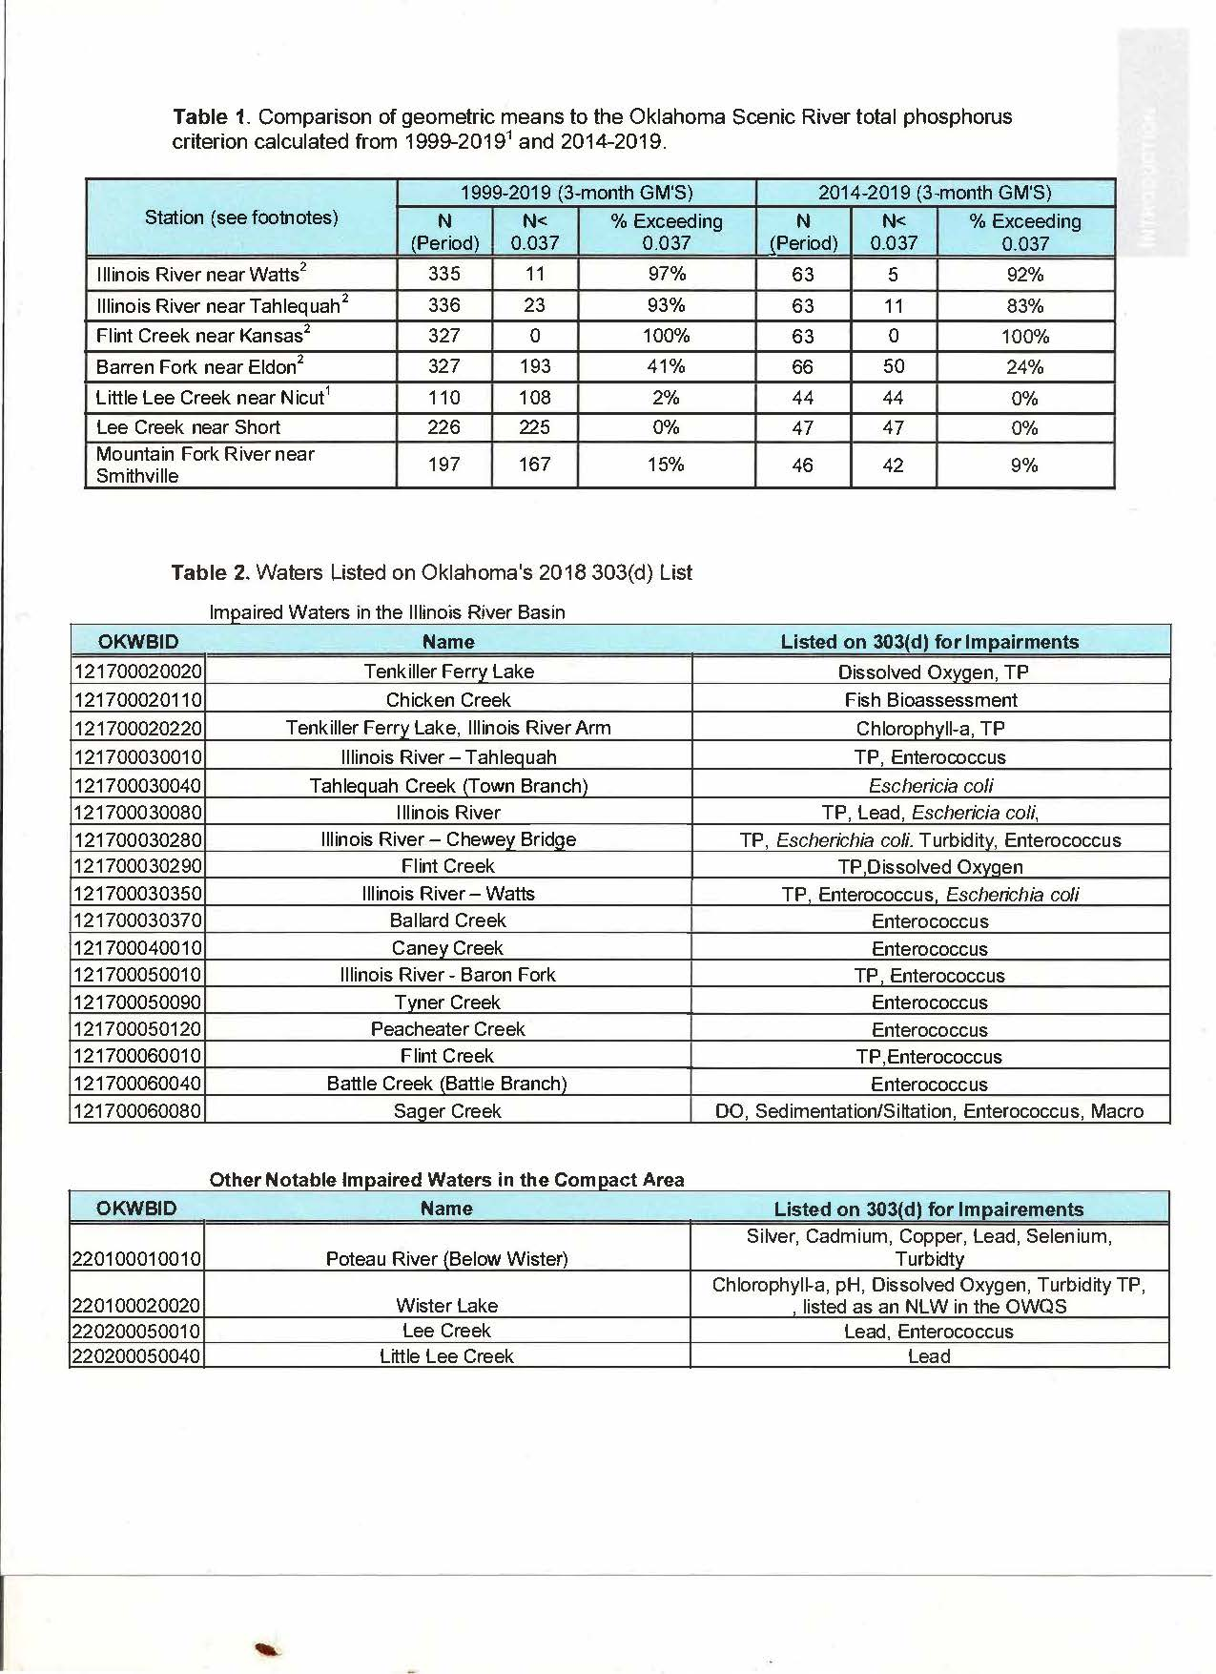

Slide 24
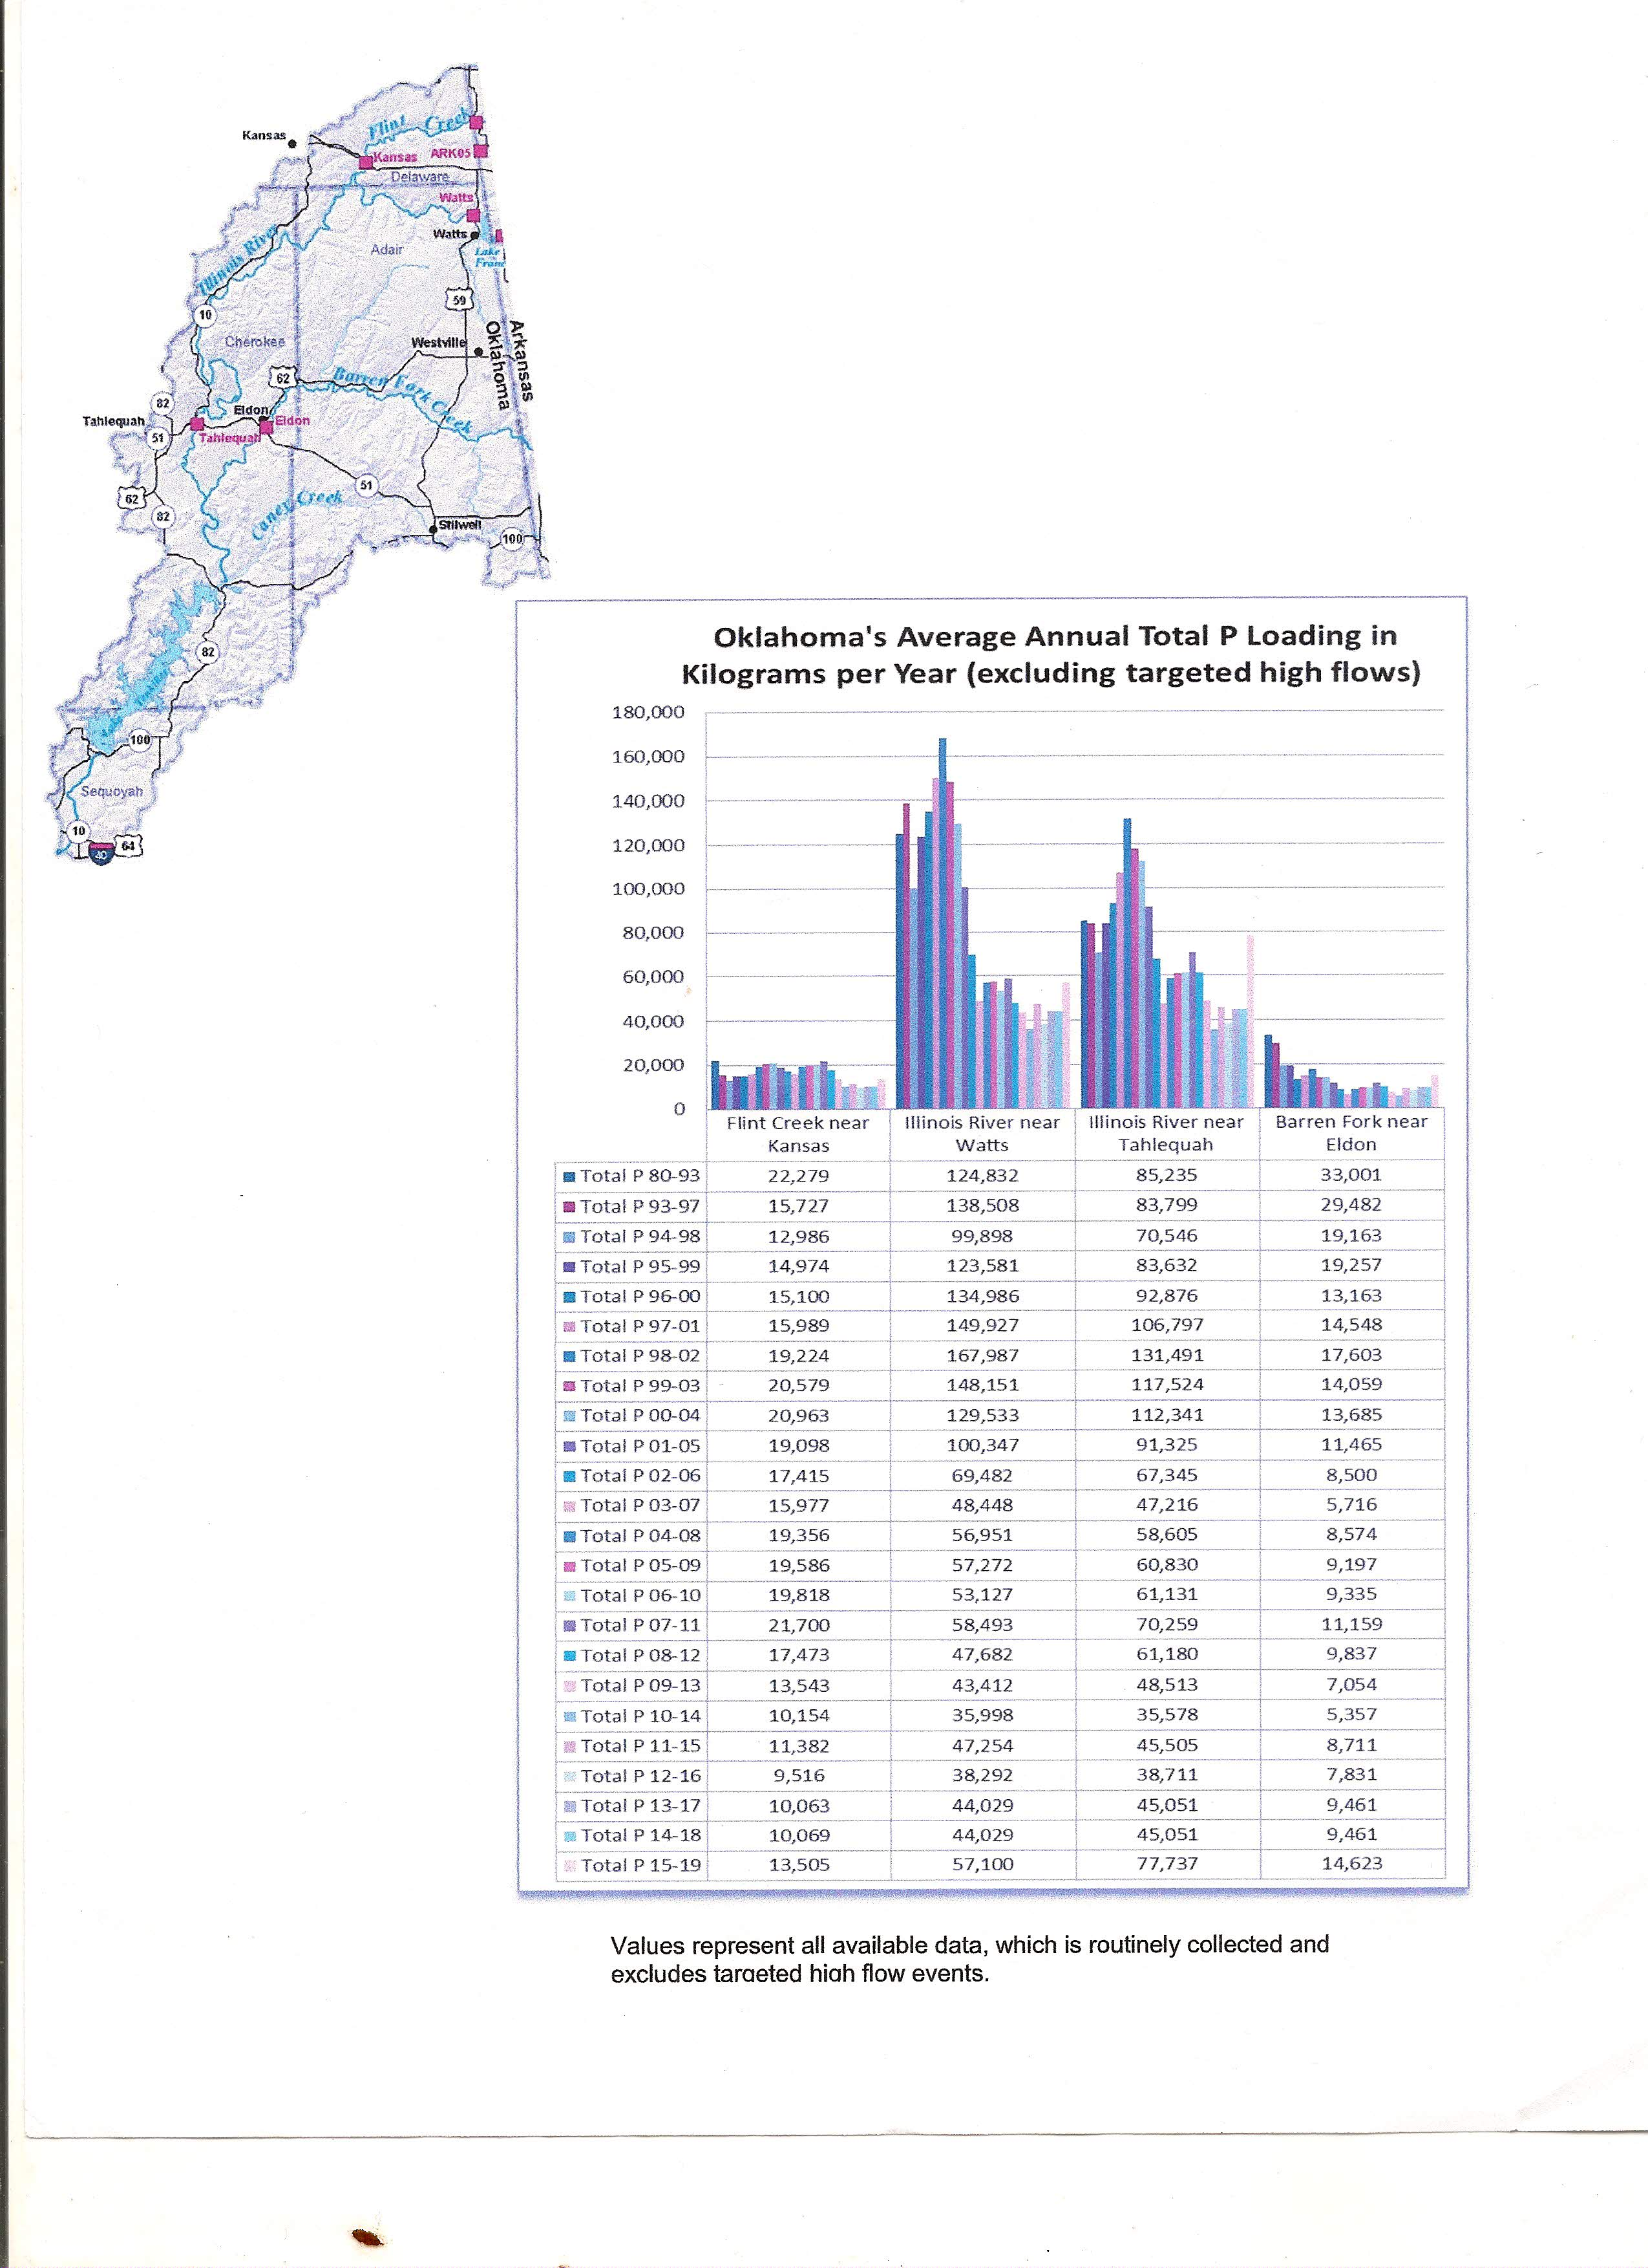

Slide 25
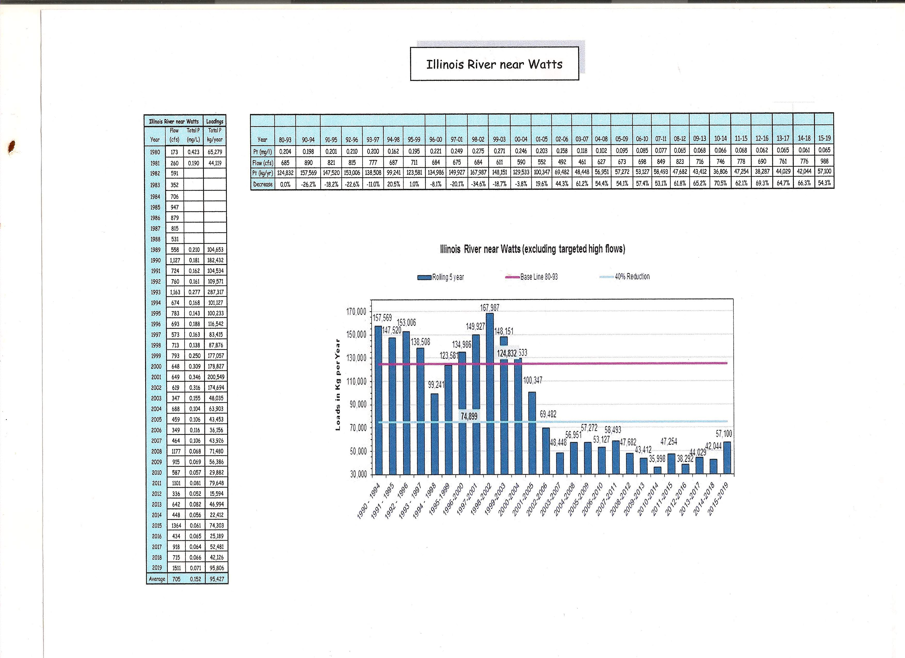

Slide 26
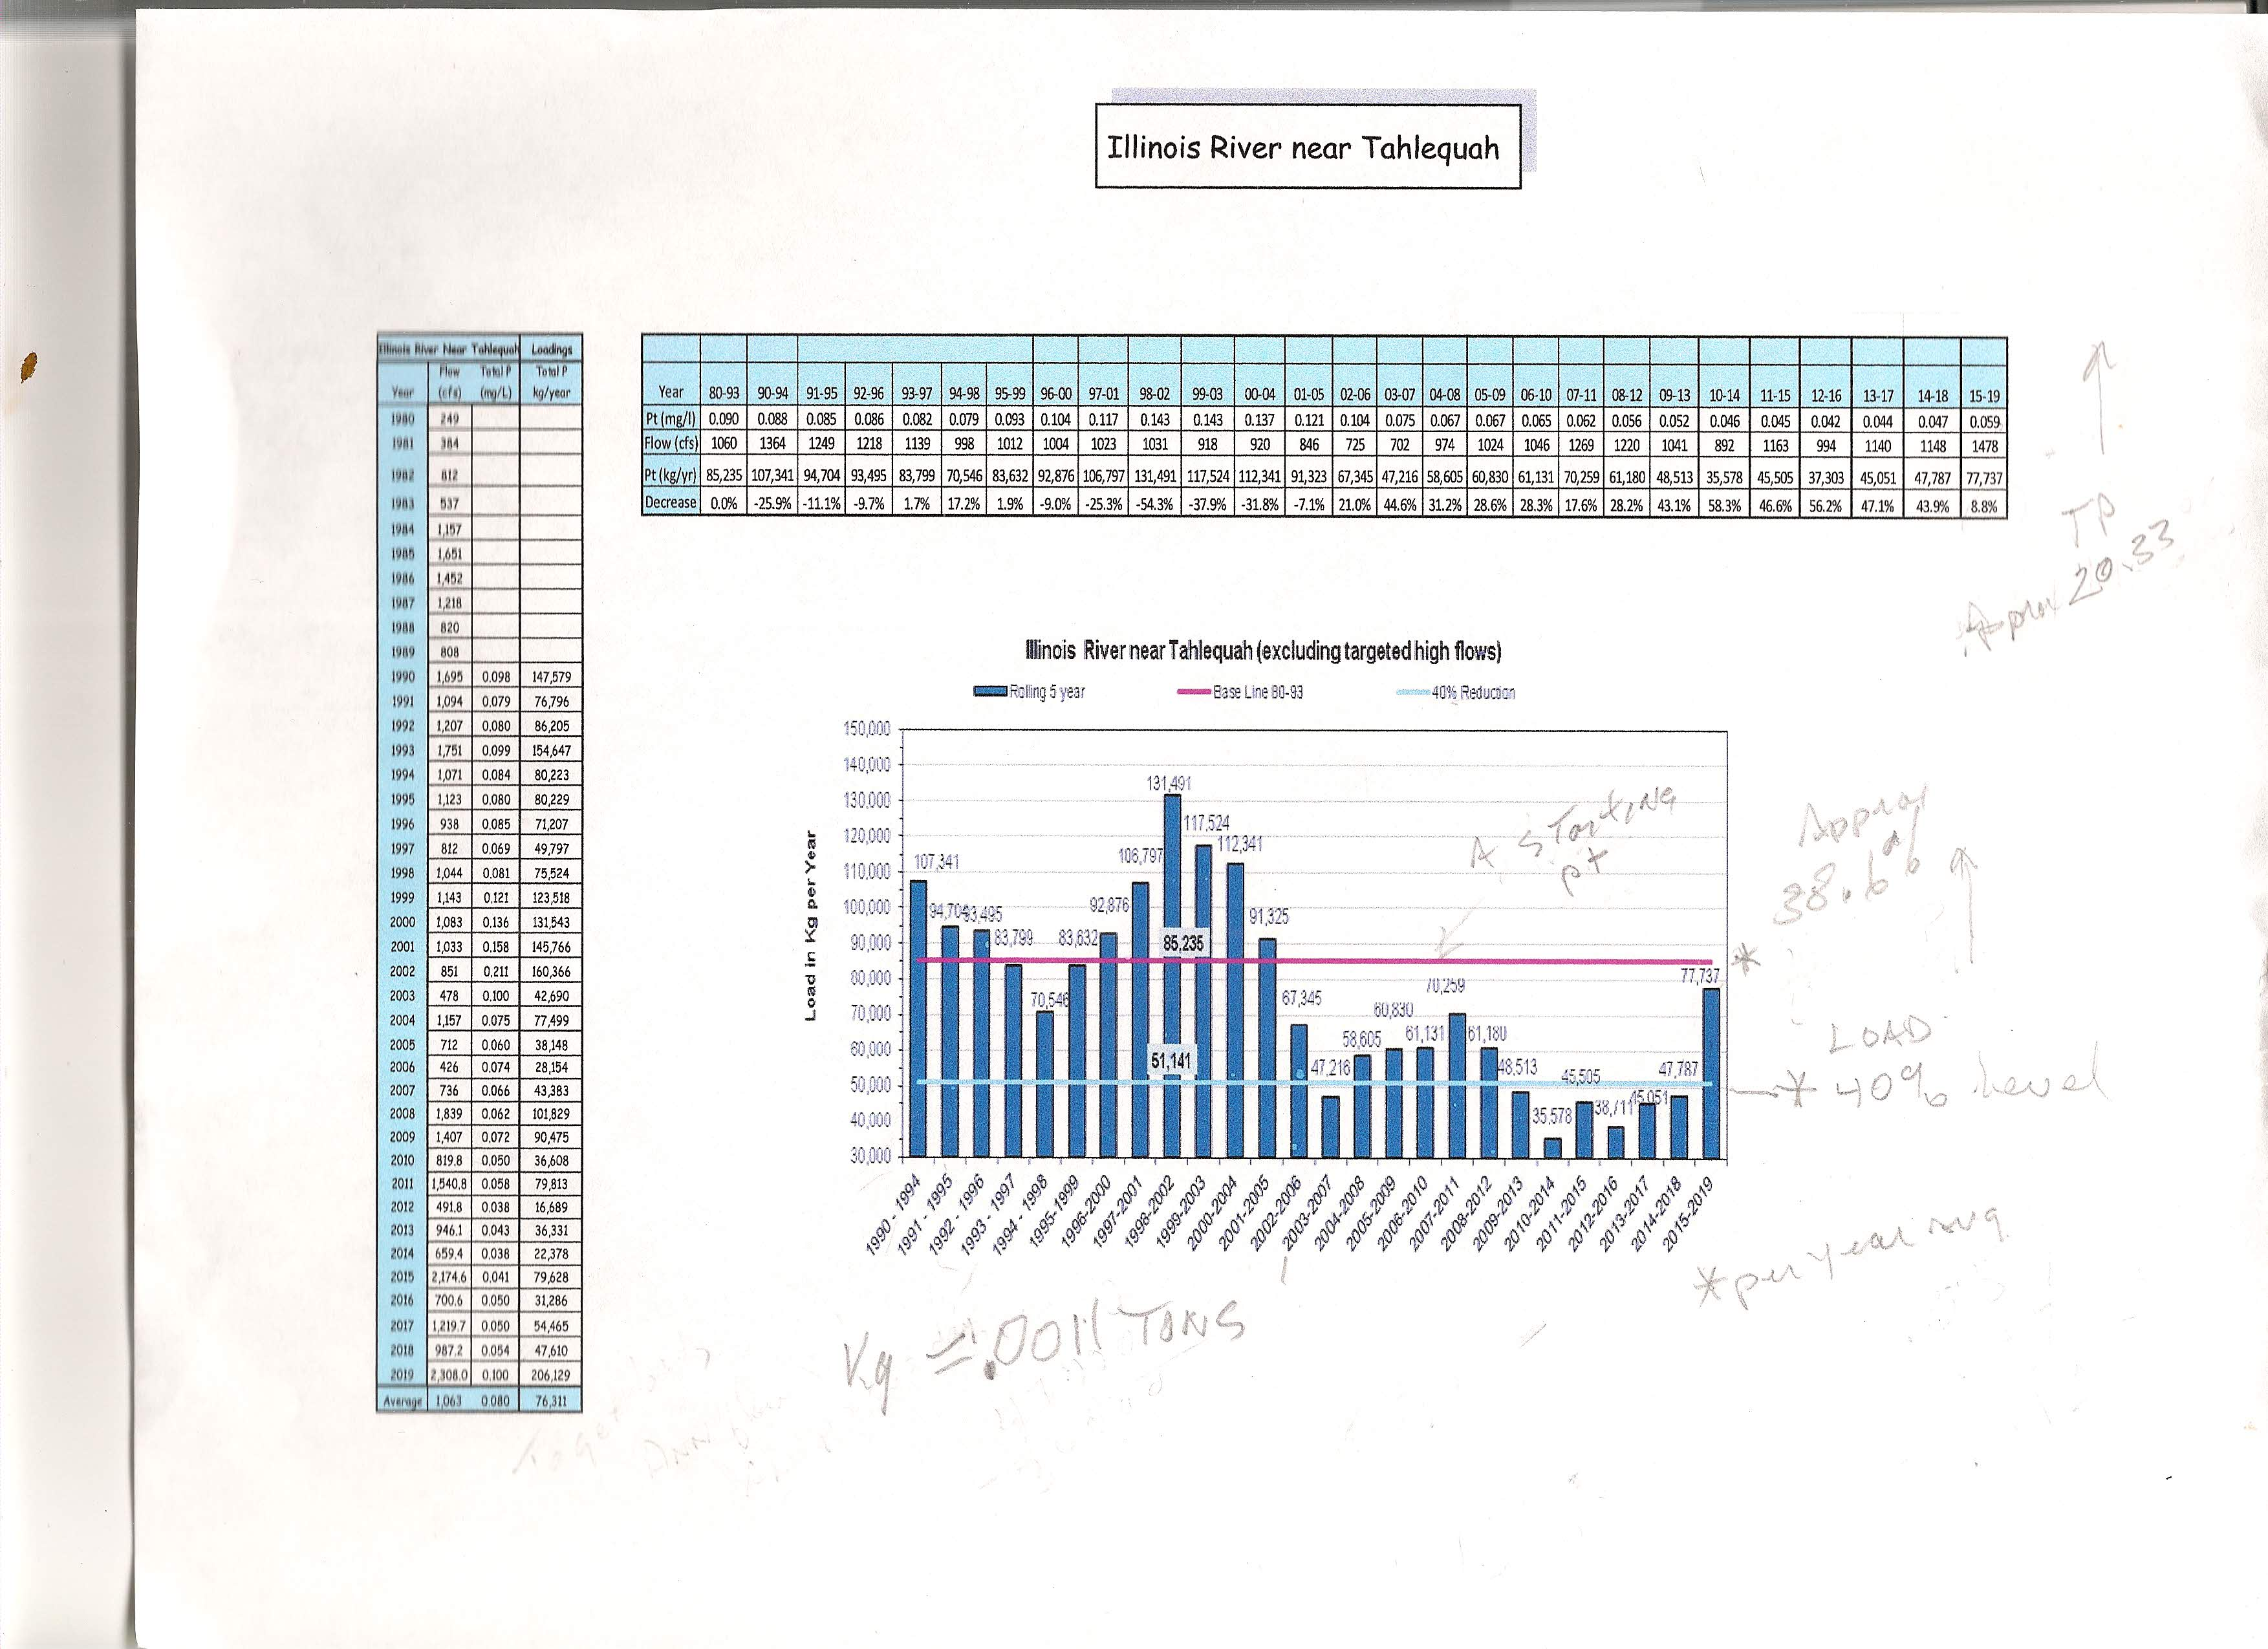

Slide 27
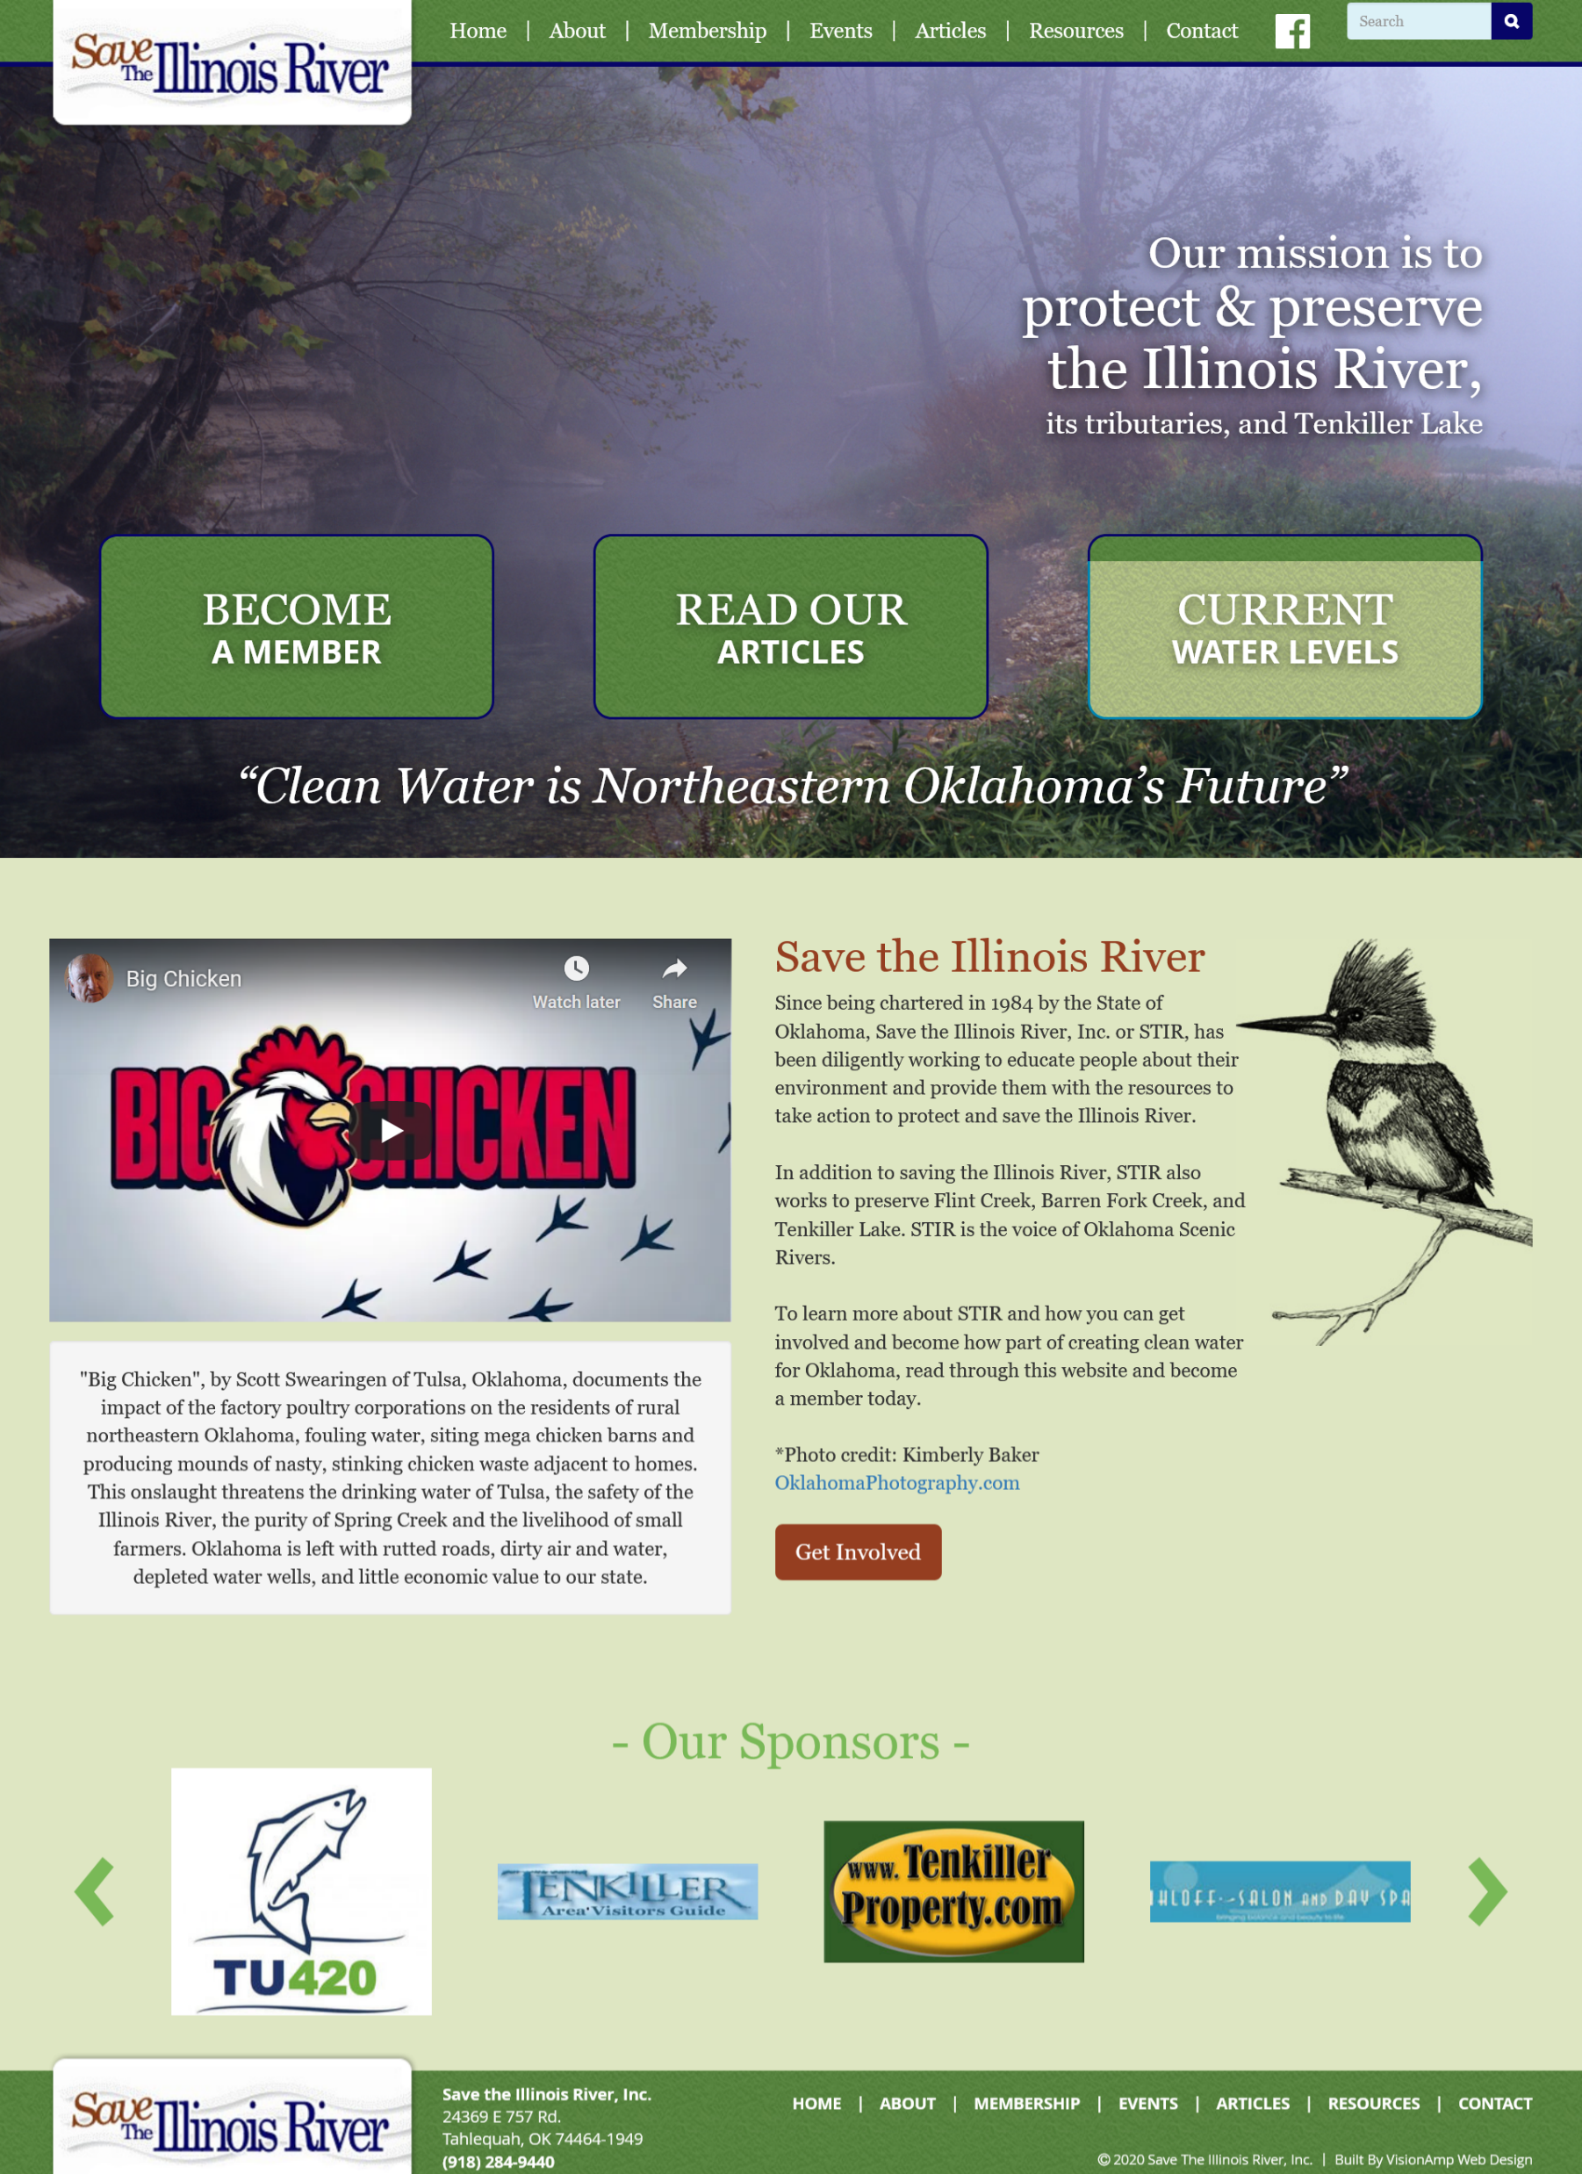
See: Articles and Resources at info@illinoisriver.org

Slide 28
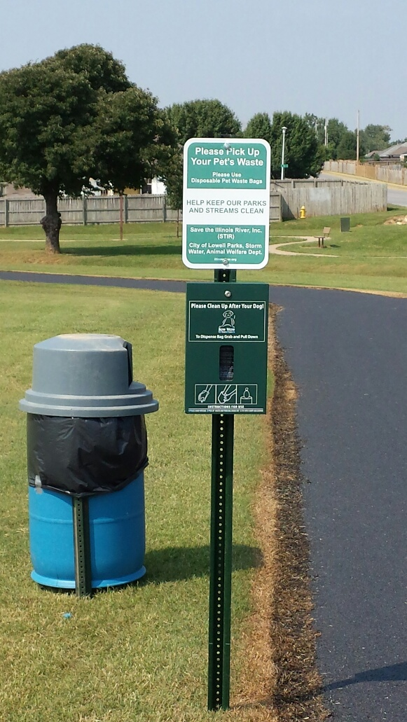
Pet Waste Disposal Stations Provided by STIR

Slide 29
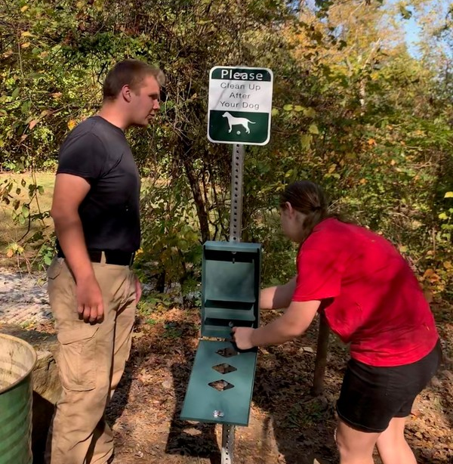
Eagle Scout Project on Illinois River Access Points

Slide 30
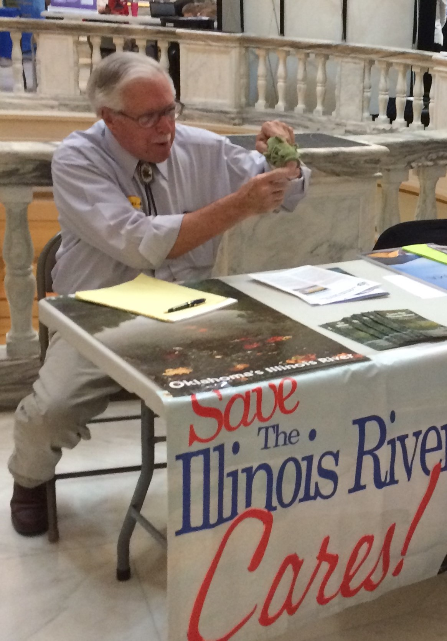
Public Education

Slide 31
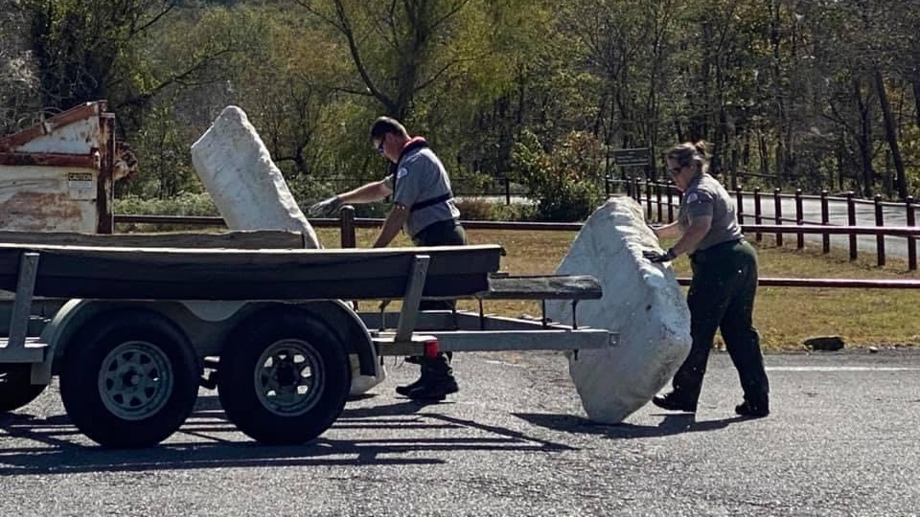
Tidy Up Tenkiller, October 2020

Slide 32
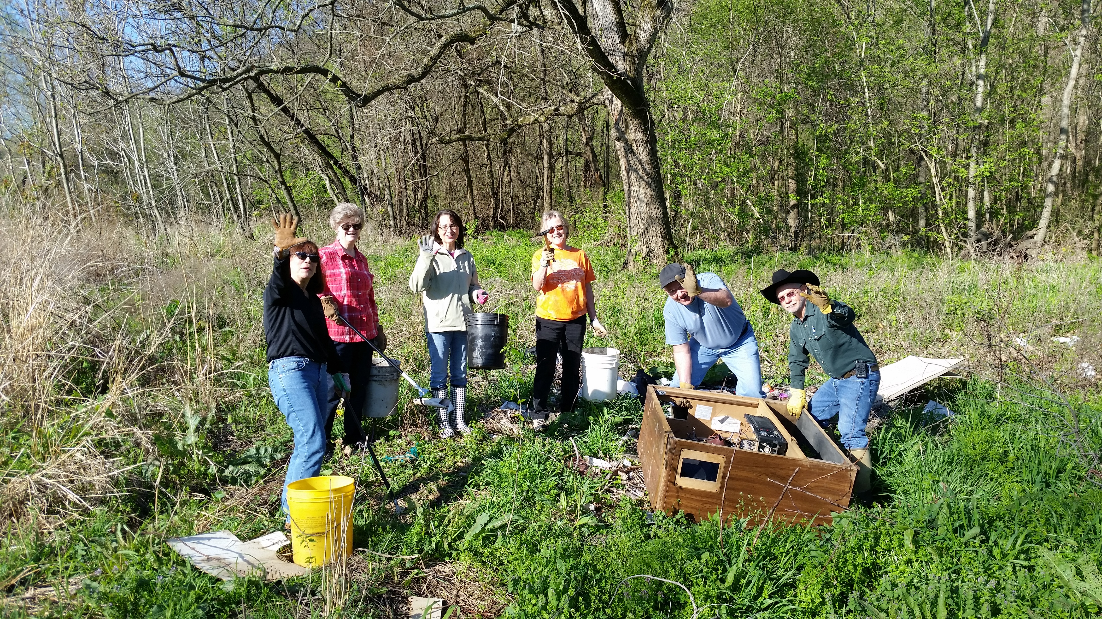
Litter Cleanup

Slide 33

Cleo, Costume by Zoe

Slide 34


